Slide 1
The RESPIRATORY System
Unit 3
Transportation Systems

Slide 2
The Respiratory System

Slide 3
Functions of the Respiratory System
Warms, moistens, and filters incoming air
Nasal cavity
Resonating chambers for speech and sound production
Larynx generates the sound, many chambers for resonation
Gas exchange.
Alveoli exchange CO₂ for O₂

Slide 4
Structures of the Respiratory System

Slide 5
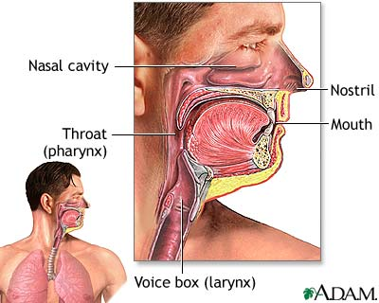
Nose
Made of bone, cartilage, skin and lined with mucous membrane
Nostrils
Septum
Warms, moistens, and filters air

Slide 6
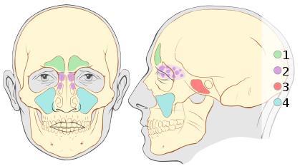
Nasal Cavity
Large, air-filled space
Above and posterior to the nose
What does all this extra space do?
Air is warmed, filtered, and humidified.
Resonation chamber for speech/sounds
Holds nerve endings for sense of smell
Sinuses

Slide 7
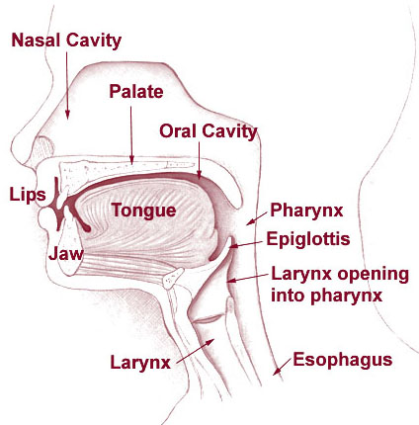
Pharynx
Funnel-shaped tube
Location?
Composed of skeletal muscle
Lined with mucous membranes.
Passageway for air and food
Resonation chamber for speech and sounds

Slide 8
Epiglottis
Inferior to the pharynx
Attached at the entrance of the larynx.
Flap of cartilage that covers the larynx during swallowing
Prevents food from entering the larynx and trachea.

Slide 9
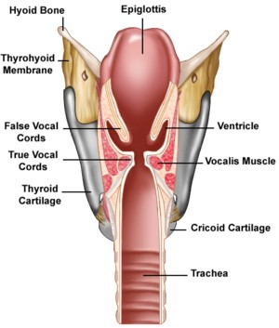
Larynx (voice box)
Inferior to the pharynx
Contains vocal cords
Short passageway that connects the pharynx and the trachea.

Slide 10
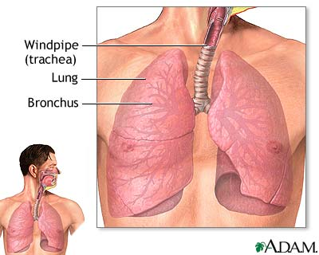
Trachea
Passageway for air.
Anterior to the esophagus.
Extends from the larynx to the center of the chest
Supported by cartilage rings to prevent collapse.

Slide 11
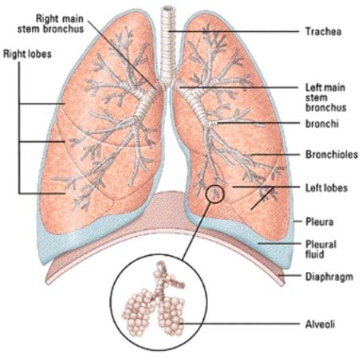
Lungs

Slide 12
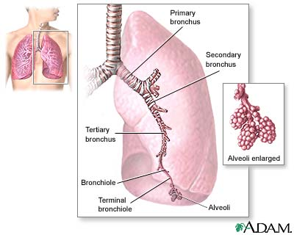
Bronchi (Bronchus)
The trachea branches into 2 large tubes that enter the lungs.
Passageway for air.

Slide 13
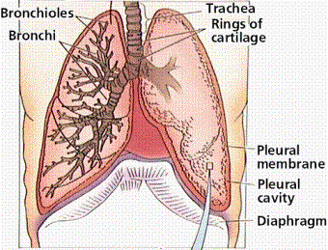
Bronchioles
Bronchi are further divided to form smaller tubes called bronchioles.
Passageway for air.

Slide 14
Alveoli
Located at the end of the bronchioles.
Small air sacs which are one-cell thick and surrounded by many blood capillaries.
Site of gas exchange between air and blood.

Slide 15
Diseases and Disorders
Common Cold (Coryza)
Pneumonia
Lung Cancer
Asthma
Bronchitis
Tuberculosis
Influenza
Emphysema

Slide 16
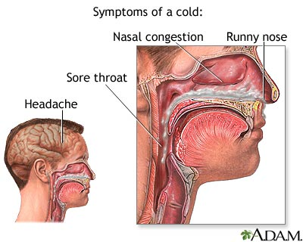
Acute Coryza (Common Cold)
Caused by one of many viruses.
Signs and symptoms include fatigue, sneezing, coughing, congestion, body aches and pains, and nasal secretions.
Can be treated by medication to reduce discomfort of signs and symptoms.

Slide 17
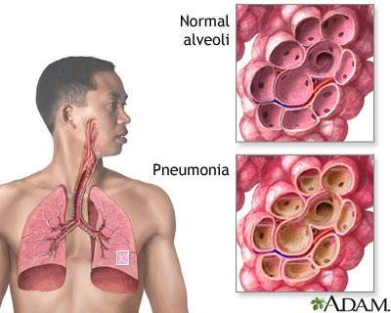
Pneumonia
Inflammatory illness of the lung.
Lung inflammation and abnormal alveolar filling.
Caused by bacteria, viruses, fungi, parasites, and chemical or physical injury to the lungs.
Symptoms include cough, chest pain, fever, and difficulty breathing.
Usually treated by antibiotics.

Slide 18
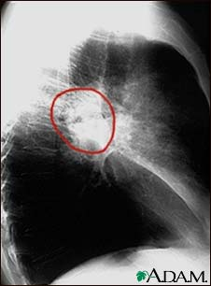
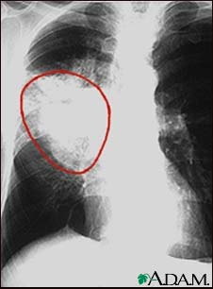
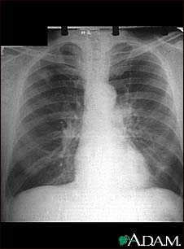
Lung Cancer

Slide 19
Lung Cancer
Disease of uncontrolled cell growth in tissues of the lung.
Growth may lead to invasion of adjacent tissues and infiltration beyond the lungs.
Most common symptoms are shortness of breath, coughing, and weight loss.
Common cause is long term exposure to tobacco smoke.
Treatments include surgery, chemotherapy, and radiation.

Slide 20
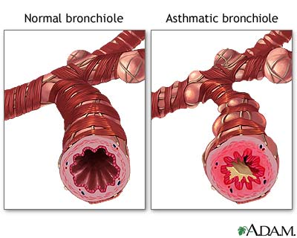
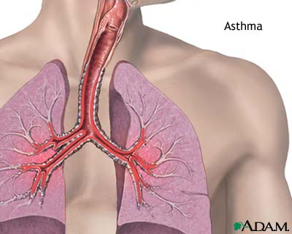
Asthma
Reversible obstructive airway disease.
Characterized by periods of coughing, difficulty breathing, or wheezing.
Caused by spasms of the smooth muscle that line the wall of the smaller bronchi and bronchioles.
Treated by antibiotics or the use of an inhaler.

Slide 21
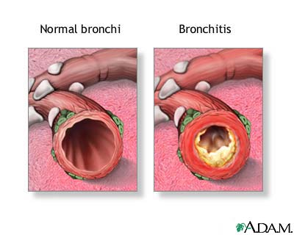
Bronchitis
Inflammation of the bronchi.
Caused by genetics, air pollution, carbon monoxide, respiratory infection, and deficient antibody levels.
Treated by antibiotics.

Slide 22
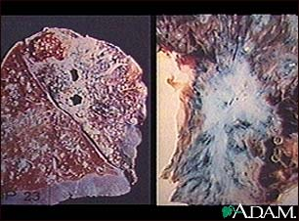
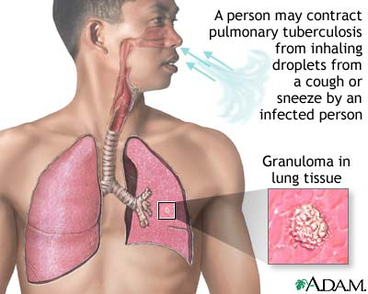
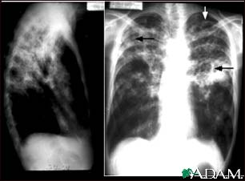
Tuberculosis
Infectious, communicable disease that destroys the lung tissue and pleura.
Inhaled respiratory droplets spread disease.
Treated by medications.

Slide 23
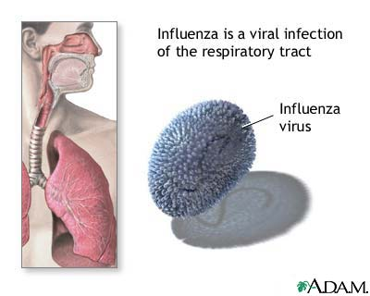
Influenza
Contagious respiratory illness caused by flu viruses.
Usually comes on suddenly and may include fever, chills, headache, extreme tiredness, cough, sore throat, runny or stuffy nose and muscle aches.

Slide 24
Emphysema
Alveoli become stretched out and cannot push carbon dioxide and other pollutants out of the lungs.
Caused by smoking, frequent untreated respiratory infections, asthma, and abnormal stress on the lungs.
Symptoms are anxiety, shortness of breath, difficulty breathing, cough, cyanosis, unequal chest expansion, elevated body temperature.
Treatment options are medications, oxygen, and the possibility of a lung transplant.

Slide 25
Emphysema

